Slide 1


Basics

Slide 2





About Me
A Sophomore pursuing ECE at BBIT, getting my hands dirty in the aspects of technology.
A Hackathon Evangelist, Tech Fest participant, and an enthusiastic learner who is trying to make an impact in the developer community.
Also, Chapter Lead of H2STC BBIT,
A level 17 Google Crowdsource Contributor.
Tithi Bose
2022 HACKTOBERFEST. ALL RIGHTS RESERVED

Slide 3
Agenda for today:
Introduction to Git & GitHub (Sped up Edition)
2. A brief Introduction to Hacktoberfest & how to contribute to open source
2022 HACKTOBERFEST. ALL RIGHTS RESERVED

Slide 4

DigitalOcean / The legacy
Intro to Git
2022 HACKTOBERFEST. ALL RIGHTS RESERVED

Slide 5
What is Git?
Git is a popular version control system. It was created by Linus Torvalds in 2005, and has been maintained by Junio Hamano since then.
It is used for:
1.Tracking code changes
2.Tracking who made changes
3.Coding collaboration
What does Git do?
1.Manage projects with Repositories
2.Clone a project to work on a local copy
3.Control and track changes with Staging and Committing
4.Branch and Merge to allow for work on different parts and versions of a project
5.Pull the latest version of the project to a local copy
6.Push local updates to the main project
Working with Git
1.Initialize Git on a folder, making it a Repository
2.Git now creates a hidden folder to keep track of changes in that folder
3.When a file is changed, added or deleted, it is considered modified
4.You select the modified files you want to Stage
5.The Staged files are Committed, which prompts Git to store a permanent snapshot of the files
6.Git allows you to see the full history of every commit.
7.You can revert back to any previous commit.
8.Git does not store a separate copy of every file in every commit, but keeps track of changes made in each commit!
2022 HACKTOBERFEST. ALL RIGHTS RESERVED

Slide 6
Why Git?
Over 70% of developers use Git!
Developers can work together from anywhere in the world, see the full history of the project, revert to earlier versions of a project.
What is GitHub?
Git is not the same as GitHub. GitHub makes tools that use Git.
GitHub is the largest host of source code in the world, and has been owned by Microsoft since 2018.
Git Install
You can download Git for free from the following website: https://www.git-scm.com/
Using Git with Command Line
To start using Git, we are first going to open up our Command shell.
For Windows, you can use Git bash, which comes included in Git for Windows. For Mac and Linux you can use the built-in terminal.
The first thing we need to do, is to check if Git is properly installed:
Configure Git
Now let Git know who you are. This is important for version control systems, as each Git commit uses this information:
git config --global user.name “username-test"
git config --global user.email "test@abc.com"
2022 HACKTOBERFEST. ALL RIGHTS RESERVED

Slide 7
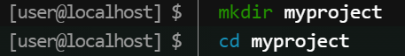
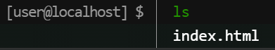
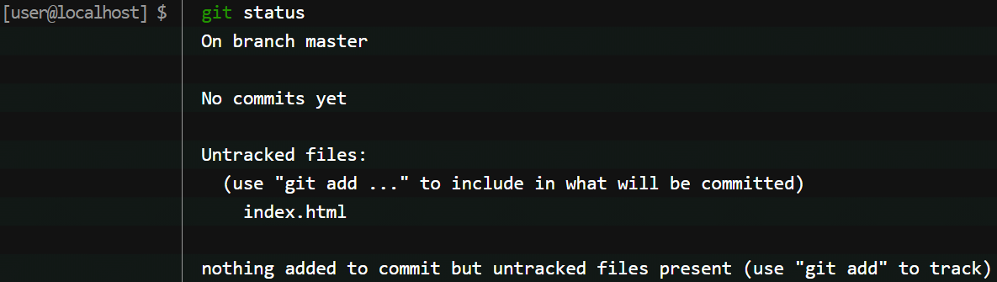
Creating Git Folder
mkdir makes a new directory.
cd changes the current working directory.
Note: If you already have a folder/directory you would like to use for Git:
Navigate to it in command line, or open it in your file explorer, right-click and select "Git Bash here“
Initialize Git
Once you have navigated to the correct folder, you can initialize Git on that folder:
Git Adding New Files
You just created your first local Git repo. But it is empty.
So let's add some files, or create a new file using your favourite text editor. Then save or move it to the folder you just created
. For this example, I am going to use a simple HTML file: save it to our new folder as index.html.
Let's go back to the terminal and list the files in our current working directory:
ls will list the files in the directory.
We can see that index.html is there.
Then we check the Git status and
see if it is a part of our repo:
2022 HACKTOBERFEST. ALL RIGHTS RESERVED

Slide 8
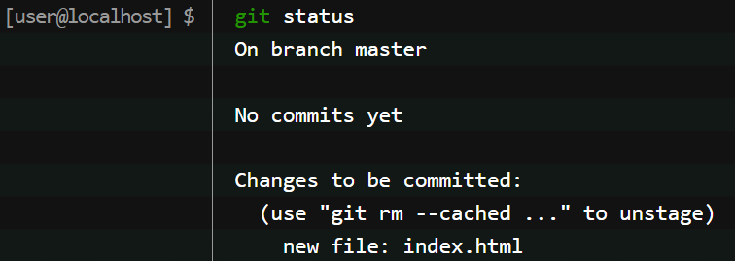
Now Git is aware of the file, but has not added it to our repository!
Files in your Git repository folder can be in one of 2 states:
1.Tracked - files that Git knows about and are added to the repository
2.Untracked - files that are in your working directory, but not added to the repository. When you first add files to an empty repository, they are all untracked. To get Git to track them, you need to stage them, or add them to the staging environment.
Git Staging Environment
One of the core functions of Git is the concepts of the Staging Environment, and the Commit.
As you are working, you may be adding, editing and removing files. But whenever you hit a milestone or finish a part of the work, you should add the files to a Staging Environment. Staged files are files that are ready to be committed to the repository you are working on. You will learn more about commit shortly.
For now, we are done working with index.html. So we can add it to the Staging Environment:
The file should be Staged. Let's check the status:
To add multiple files in the current directory to the Staging Environment:
Git Commit
Since we have finished our work, we are ready move from stage to commit for our repo. Adding commits keep track of our progress and changes as we work. Git considers each commit change point or "save point". It is a point in the project you can go back to if you find a bug, or want to make a change. When we commit, we should always include a message. By adding clear messages to each commit, it is easy for yourself (and others) to see what has changed and when. The commit command performs a commit, and the -m "message" adds a message
2022 HACKTOBERFEST. ALL RIGHTS RESERVED

Slide 9
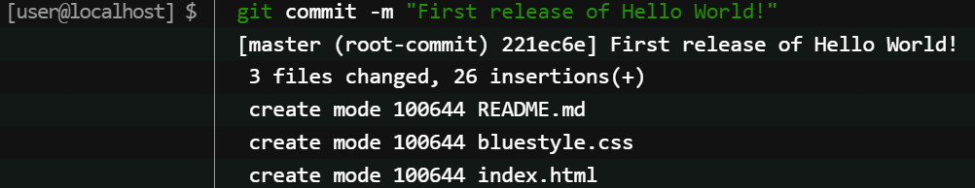
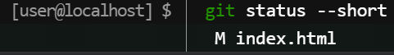
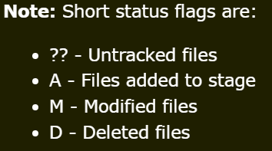
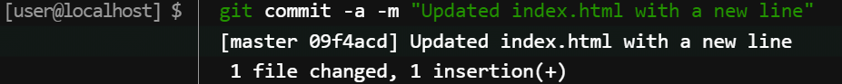
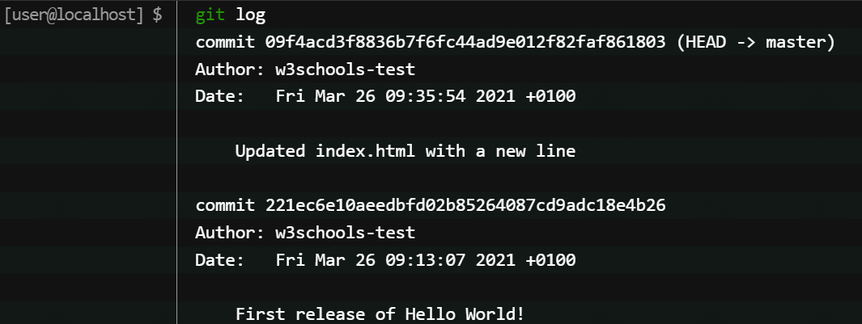
Git Commit without Stage
Sometimes, when you make small changes, using the staging environment seems like a waste of time. It is possible to commit changes directly, skipping the staging environment. The -a option will automatically stage every changed, already tracked file & check the status of our repository. But this time, we will use the --short option to see the changes in a more compact way:
We see the file we expected is modified. So let's commit it directly:
Warning: Skipping the Staging Environment is not generally recommended.
Skipping the stage step can sometimes make you include unwanted changes.
Git Commit Log- To view the history of commits for a repository, you can use the log command:
2022 HACKTOBERFEST. ALL RIGHTS RESERVED

Slide 10
Git Help
If you are having trouble remembering commands or options for commands, you can use Git help.
There are a couple of different ways you can use the help command in command line:
git command -help - See all the available options for the specific command
git help --all - See all possible commands
Working with Git Branches
In Git, a branch is a new/separate version of the main repository. Let's say you have a large project, and you need to update the design on it. How would that work without and with Git:
Without Git:
1.Make copies of all the relevant files to avoid impacting the live version
2.Start working with the design and find that code depend on code in other files, that also need to be changed!
3.Make copies of the dependant files as well. Making sure that every file dependency references the correct file name
4.EMERGENCY! There is an unrelated error somewhere else in the project that needs to be fixed ASAP!
5.Save all your files, making a note of the names of the copies you were working on. Work on the unrelated error and update the code to fix it.
6. Go back to the design, and finish the work there. Copy the code or rename the files, so the updated design is on the live version
(2 weeks later, you realize that the unrelated error was not fixed in the new design version because you copied the files before the fix)
With Git:
1.With a new branch called new-design, edit the code directly without impacting the main branch
2.EMERGENCY! There is an unrelated error somewhere else in the project that needs to be fixed ASAP!
3.Create a new branch from the main project called small-error-fix. Fix the unrelated error and merge the small-error-fix branch with the main branch
4.You go back to the new-design branch, and finish the work there. Merge the new-design branch with main (getting alerted to the small error fix that you were missing). Branches allow you to work on different parts of a project without impacting the main branch.
When the work is complete, a branch can be merged with the main project. You can even switch between branches and work on different projects without them interfering with each other. Branching in Git is very lightweight and fast!
2022 HACKTOBERFEST. ALL RIGHTS RESERVED

Slide 11
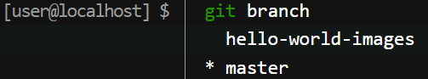
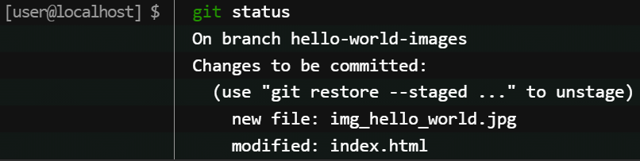
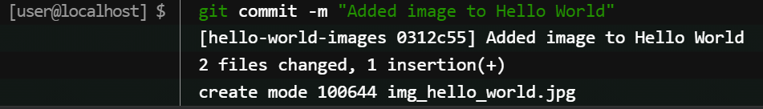
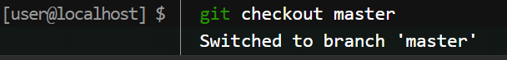
New Git Branch
We are working in our local repository, and we do not want to disturb or possibly wreck the main project. So we create a new branch::
Now we created a new branch called "hello-world-images"
Let's confirm that we have created a new branch:
We can see the new branch with the name "hello-world-images", but the * beside master specifies that we are currently on that branch.
checkout is the command used to check out a branch. Moving us from the current branch, to the one specified at the end of the command:
Now we have moved our current workspace from the master branch,
to the new branch
We have made changes to a file and added a new file in the working directory (same directory as the main branch).
Using --all instead of individual filenames will Stage all changed (new, modified, and deleted) files.
We are happy with our changes. So we will commit them to the branch: Now we have a new branch, that is different from the master branch.
Note: Using the -b option on checkout will create a new branch, and move to it, if it does not exist.
Switching Between Branches
Now let's see just how quick and easy it is to work with different branches, and how well it works.
We are currently on the branch hello-world-images. We added an image to this branch, so let's list the files in the current directory:
We can see the new file img_hello_world.jpg, and if we open the html file, we can see the code has been altered. All is as it should be.
Now, let's see what happens when we change branch to master
nch
2022 HACKTOBERFEST. ALL RIGHTS RESERVED

Slide 12
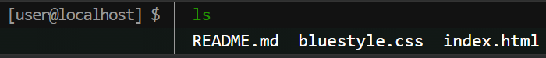
The new image is not a part of this branch. List the files in the current directory again. img_hello_world.jpg is no longer there! And if we open the html file, we can see the code reverted to what it was before the alteration.
Merge Branches
Since the emergency-fix branch came directly from master, and no other changes had been made to master while we were working, Git sees this as a continuation of master. So it can "Fast-forward", just pointing both master and emergency-fix to the same commit.
As master and emergency-fix are essentially the same now, we can delete emergency-fix, as it is no longer needed.
It is done using git merge command.
About merge conflicts
Merge conflicts happen when you merge branches that have competing commits, and Git needs your help to decide which changes to incorporate in the final merge. You must resolve all merge conflicts before you can merge a pull request on GitHub. If you have a merge conflict between the compare branch and base branch in your pull request, you can view a list of the files with conflicting changes above the Merge pull request button. The Merge pull request button is deactivated until you've resolved all conflicts between the compare branch and base branch.
Suggested resources for further reading:
https://docs.github.com/en
2022 HACKTOBERFEST. ALL RIGHTS RESERVED

Slide 13


DigitalOcean / The legacy
Intro to GitHub
2022 HACKTOBERFEST. ALL RIGHTS RESERVED

Slide 14
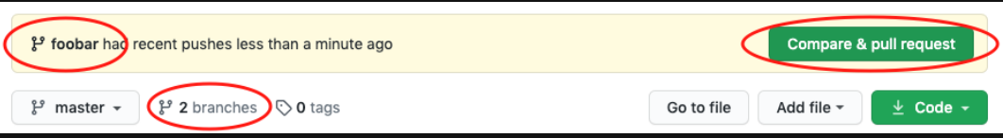
GitHub Account
1.Go to GitHub and sign up for an account: https://github.com/
2.Create a Repository on GitHub- Now that you have made a GitHub account, sign in, and create a new Repo using the plus sign at the corner & fill in the relevant details:
3. We will go over the different options and what they mean later. But for now, choose Public (if you want the repo to be viewable for anyone) or Private (if you want to choose who should be able to view the repo). Either way, you will be able to choose who can contribute to the repo.
Then click "Create repository".
4. Now we'll push the commit in your branch to your new GitHub repo. This allows other people to see the changes you've made. If they're approved by the repository's owner, the changes can then be merged into the primary branch.
To push changes onto a new branch on GitHub, you'll want to run git push origin yourbranchname. GitHub will automatically create the branch for you on the remote repository.
You might be wondering what that "origin" word means in the command above. What happens is that when you clone a remote repository to your local machine, git creates an alias for you. In nearly all cases this alias is called "origin." It's essentially shorthand for the remote repository's URL. So, to push your changes to the remote repository, you could've used either the command: git push git@github.com:git/git.git yourbranchname or git push origin yourbranchname. (If this is your first time using GitHub locally, it might prompt you to log in with your GitHub username and password.)
If you refresh the GitHub page, you'll see note saying a branch with your name has just been pushed into the repository. You can also click the 'branches' link to see your branch listed there.
A pull request (or PR) is a way to alert a repo's owners that you want to make some changes to their code. It allows them to review the code and make sure it looks good before putting your changes on the primary branch.
This is what the PR page looks like before you've submitted it:
2022 HACKTOBERFEST. ALL RIGHTS RESERVED

Slide 15
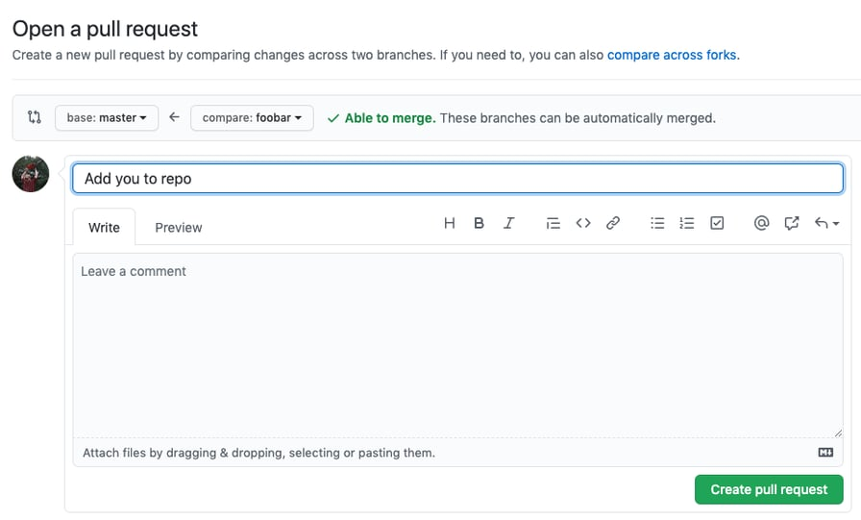
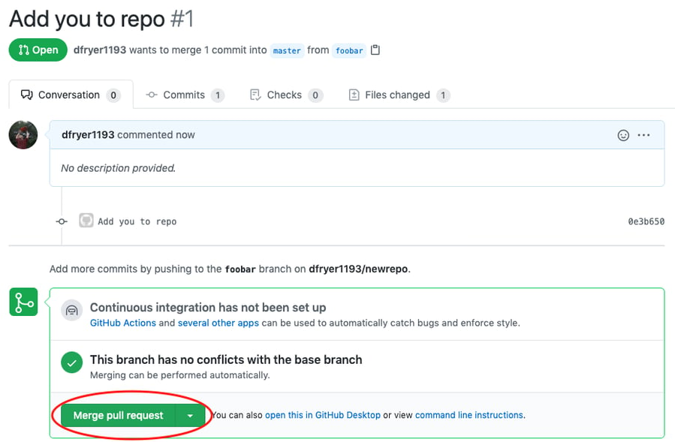
Go ahead and click the green 'Merge pull request' button. This will merge your changes into the primary branch. You can double check that your commits were merged by clicking on the 'Commits' link on the first page of your new repo. You can also see the hash code of the commit on the right hand side. A hash code is a unique identifier for that specific commit. It's useful for referring to specific commits and when undoing changes (use the git revert <hash code number> command to backtrack).
The commit you made in your branch and merged into the primary branch doesn't exist in the primary branch on your local machine.
In order to get the most recent changes that you or others have merged on GitHub, use the git pull origin master command (when working on the primary branch). In most cases, this can be shortened to “git pull”.
This shows you all the files that have changed and how they've changed.
Now we can use the git log command again to see all new commits.
(You may need to switch branches back to the primary branch. You can do that using the git checkout master command.)
2022 HACKTOBERFEST. ALL RIGHTS RESERVED

Slide 16

DigitalOcean / The legacy
You've successfully made a PR and merged your code to the primary branch. Congratulations! If you'd like to dive deeper, check out these more advanced tutorials and resources:
https://training.github.com/
Github’s official git cheat sheets! Handy for remembering the everyday commands you’ll use.
https://learngitbranching.js.org/
Confused or intrigued by git’s branch system? That just means you’re human! It’s one of the deepest parts of git, but also arguably the most powerful. Understanding the branch model gives you git superpowers, and this tutorial gives you a way to learn git branches in a visual, intuitive way.
https://git-school.github.io/visualizing-git
Another tool for exploring git visually. This one is more of an open-ended sandbox than learngitbranching.js.org
https://github.com/jlord/git-it-electron
A desktop application that helps you learn git through challenges you have to solve. It has a series of levels, each requiring you to use git commands to arrive at a correct answer.
https://github.com/Gazler/githug
If you liked git-it, Githug is another puzzle-based tutorial designed to give you a practical way of learning git.
2022 HACKTOBERFEST. ALL RIGHTS RESERVED

Slide 17
WHAT IS HACKTOBERFEST?
Hacktoberfest
2022 HACKTOBERFEST. ALL RIGHTS RESERVED

Slide 18
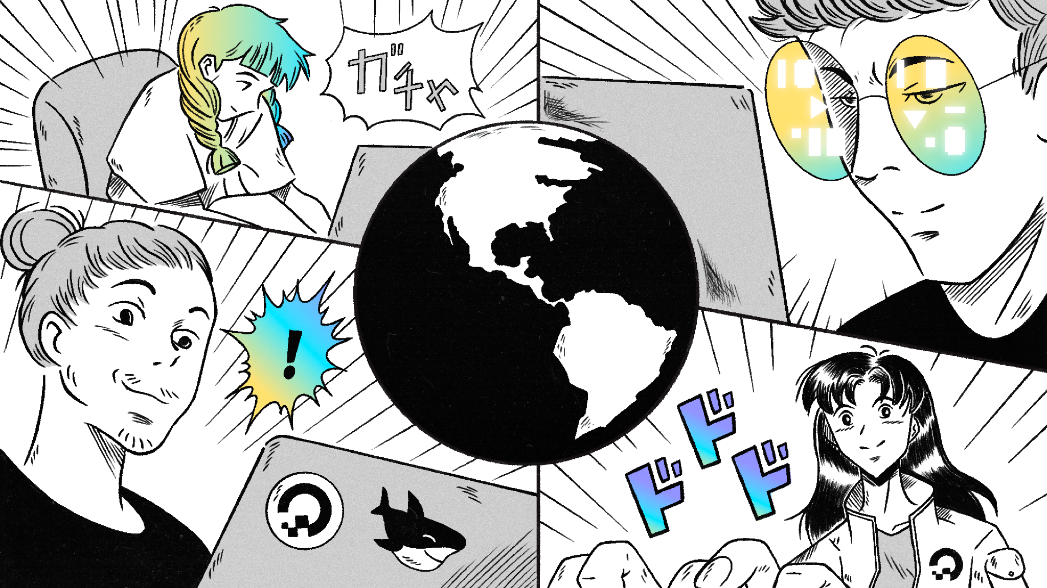

Slide 19






DigitalOcean / Sponsorship
Maintainer
Maintains an open source project / could give an entire presentation on PRs
TYPES OF PEOPLE AT HACKTOBERFEST
Beginner
Never made a pull request before / New to tech in general.
Contributor
Already contributes to open source / works in a tech role.
2022 HACKTOBERFEST. ALL RIGHTS RESERVED

Slide 20







DigitalOcean / The legacy
Once again, lets see these 3 people:
https://hacktoberfest.com/
Maintainer
Beginner
Contributor
Maintains an open source project / could give an entire presentation on PRs.
Never made a pull request before / New to tech in general
Already contributes to open source / works in a tech role
2022 HACKTOBERFEST. ALL RIGHTS RESERVED

Slide 21



DigitalOcean / The legacy
https://hacktoberfest.com/participation/
While participating, make sure that you follow all the guidelines of the event & are familiar with the basic functioning of Git & GitHub
>For GitHub mobile app users, you do not need to use git to participate as long as you are well versed with what you are doing.
2022 HACKTOBERFEST. ALL RIGHTS RESERVED

Slide 22

DigitalOcean / The legacy
hacktoberfest.digitalocean.com
2022 HACKTOBERFEST. ALL RIGHTS RESERVED

Slide 23


THANKS
FOR LISTENING
2022 HACKTOBERFEST. ALL RIGHTS RESERVED

